Slide 1

FLIGHT BOOKING MANGEMENT
A Free Platform Helps you book Flights

Slide 2

About Flight bookings
We have Flight Details in our Website where user can Book his Flight according to his wish
These details will be sent to the database for storing the information
Information like user details and Time user has booked there flight For and where is user going

Slide 3

Flight Booking Structure
In the website we have Details of Flights like airline name, Arrival time, departure Time, duration of Flight, departure date, arrival date, price of ticket, layover details, Flight Number and type
With All these details a user can book a Flight without any Issue

Slide 4

User Capabilities
From the User we collect information like FirstName, Last name, Email, password for credentials
While user can see the details or Flight Information Provided by us and book a Flight a According to there Choice

Slide 5
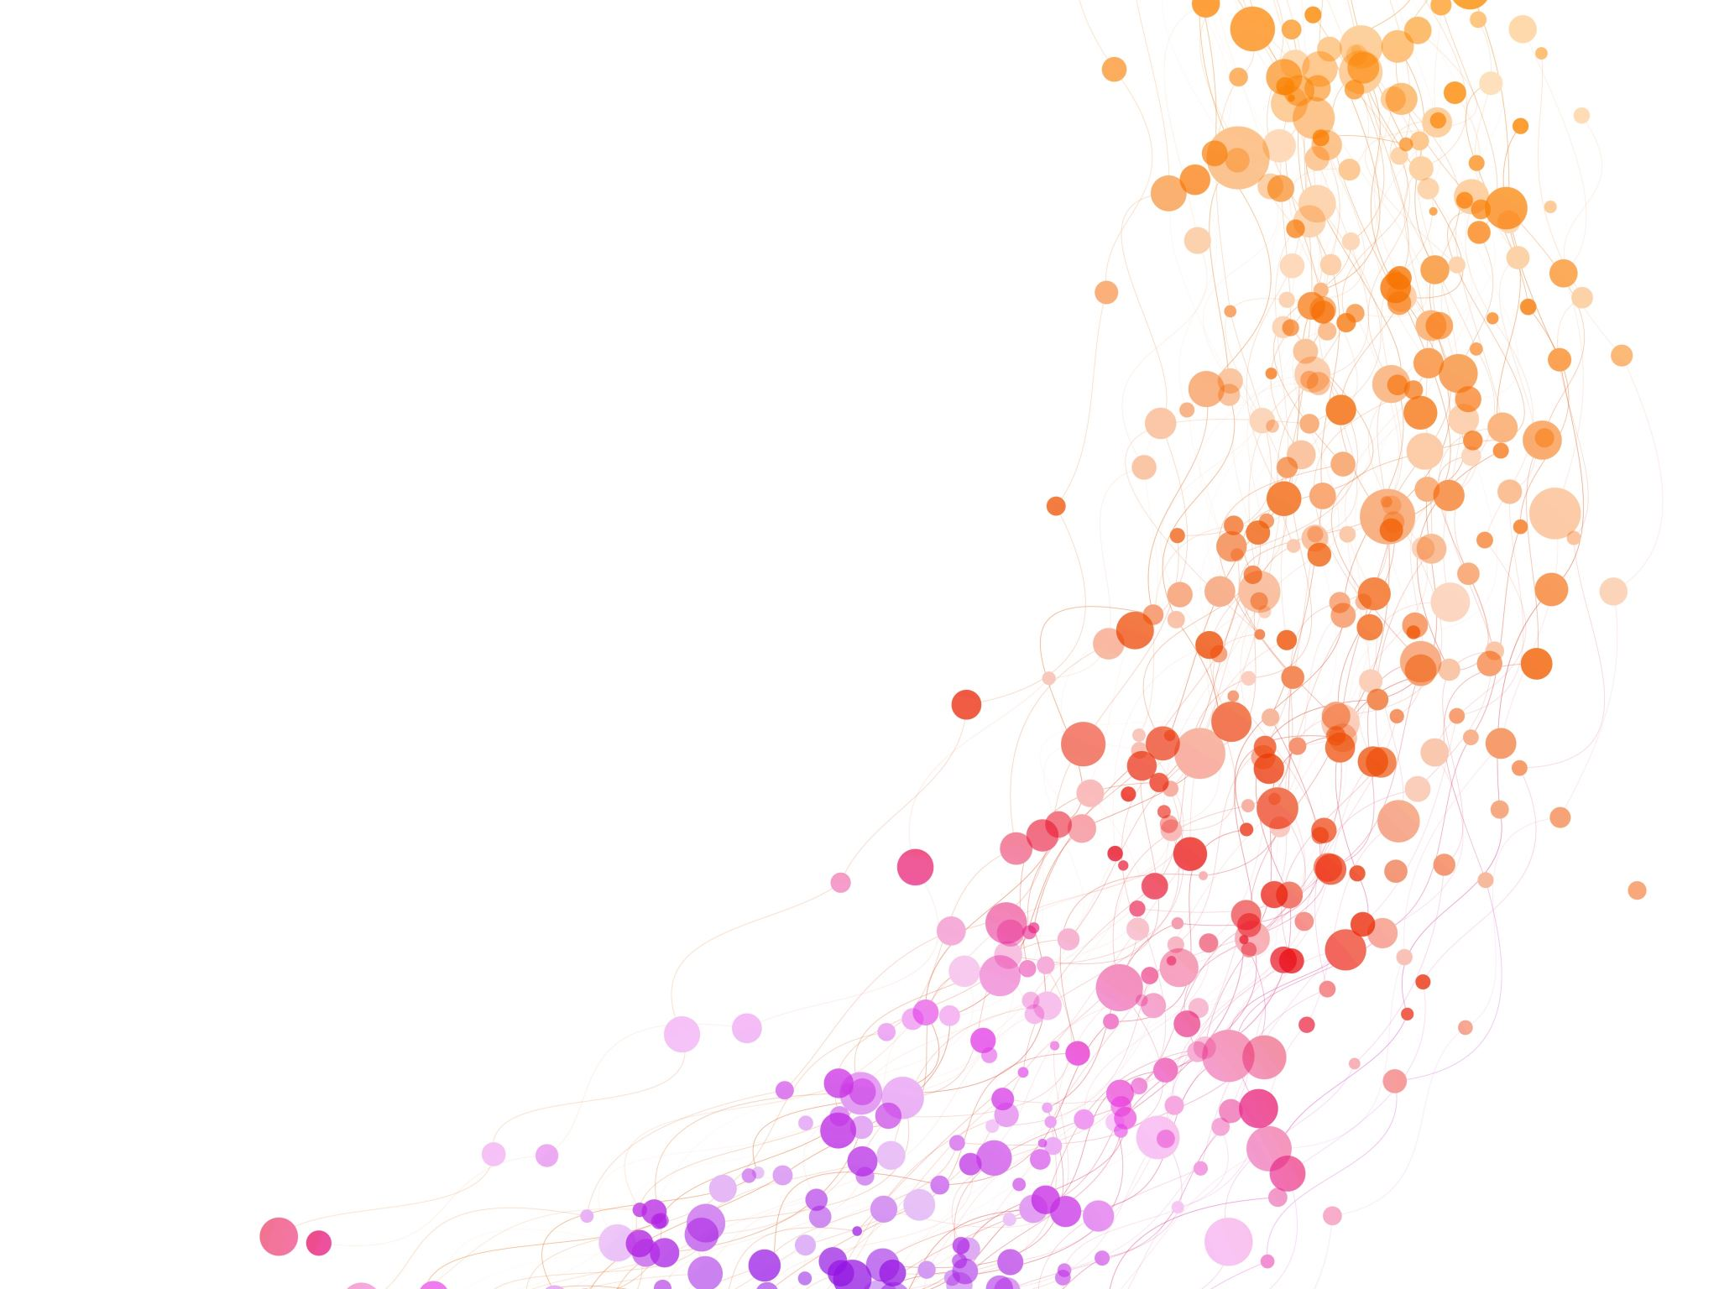
Project Backend

Slide 6
Our Tech Stack
The database We are Using is MongoDb
We are also using redux in Our Project
const mongoose = require('mongoose');
mongoose.connect('mongodb://localhost/users', { useNewUrlParser: true });
mongoose.connection
.once("open", () => console.log('Connected'))
.on("error", error => {
console.log("MongoDB Error: " + error);
})
import {createSlice, nanoid } from '@reduxjs/toolkit';
const initialState = {
user: null
}
export const userSlice = createSlice({
name:'user',
initialState,
reducers: {
addUser: (state,action) =>
{
return{
...state,
user: action.payload
}
}
}
})
export const {addUser} = userSlice.actions
export default userSlice.reducer
import {configureStore} from '@reduxjs/toolkit';
import userReducer from './userSlice';
export const store = configureStore({
reducer: userReducer
})
Store.js
Userslice.js

Slide 7

Our Project API’s We have created Controller, Models, services, routes for
1). Flights
2). Bookings
3). Users

Slide 8
Controllers
const { createFlight, getFlight } = require('../services/flightService');
const createFlightController = async (req,res,next) => {
try{
const flightData = req.body;
const newFlightId = await createFlight(flightData);
if(!newFlightId){
res.send({
message: "new flight not created"
})
return;
}
res.status(201).send({
message: "FLight Added",
id: newFlightId
})
} catch(err){
next(err);
}
}
/**
*
* @param {Request} req
* @param {Response} res
* @param {*} next
*/
const getFlightController = async (req,res,next) => {
try{
const {arrival, departure, date} = req.query;
// res.status(200).send({
// to,from,date
// });
const flights = await getFlight({arrival, departure, date});
res.send(flights);
} catch(err){
next(err);
}
}
module.exports = {
createFlightController,
getFlightController
}
onst userService = require('../services/userService');
module.exports = {
async getUsers(req, res, next){
try{
const allUsers = await userService.getUsers();
if(allUsers.length == 0){
res.status(200).send({
message: "No Users in database"
});
return;
}
res.status(200).send({
allUsers
});
} catch(err){
next(err);
}
},
async createUsers(req,res,next)
{
try
{
const user = await userService.createUsers(req.body);
if(user.error)
{
//res.json(error);
res.status(400).json(user);
}
res.status(200).json(user);
} catch(err){
next(err)
}
},
async loginUsers(req,res,next)
{
try{
const user = await userService.loginUsers(req,res);
res.json(user);
}
catch(err)
{
next(err);
}
onst { createBooking, getBooking } = require('../services/bookingService');
const getbookingsController = async (req,res,next) => {
try{
const email = req.query.email;
const bookings = await getBooking(email);
if(!bookings){
res.status(200).send({});
}
res.send(bookings);
} catch(error){
}
}
const createBookingController = async (req,res,next) => {
try{
const {flightNumber, email} = req.query;
const booking = await createBooking(email, flightNumber);
if(!booking){
res.status(400).send({
message: "booking not created"
})
}
res.status(200).send(booking);
} catch(e){
next(e);
}
}
module.exports = {
createBookingController,
getbookingsController
}
Flight controller.js
Booking controller.js
User controller.js

Slide 9
Models
const mongoose = require('mongoose');
const Flights = mongoose.model(
'flights',
new mongoose.Schema({
airline:{
type: String,
},
arrival:{
type: String
},
departure: {
type: String
},
duration: {
type: String
},
departureDate: {
type: Date
},
arrivalDate: {
type: Date
},
price: {
type: Number
},
layover: {
type: Number
},
type: {
type: String
},
providerName: {
type: String
},
flightNumber: {
type: Number
}
})
)
module.exports = Flights;
const mongoose = require('mongoose');
module.exports = mongoose.model('userInfo', new mongoose.Schema({
firstName: {
type: String,
minLength: 3,
maxLength: 25,
required: true
},
lastName: {
type: String,
minLength: 3,
maxLength: 25,
required: true
},
email:{
type: String,
required: true,
unique: true,
},
password: {
type: String,
required: true,
},
type: {
type: String
}
}))
const mongoose = require('mongoose');
const Booking = mongoose.model(
'booking',
new mongoose.Schema({
userEmail:{
type: String,
},
flightNumber:{
type: String,
}
})
)
module.exports = Booking;
bookingModels.js
Flight Models.js
User models.js

Slide 10
Routes
const userController = require("../controllers/userController");
const flightController = require("../controllers/flightController");
const bookingController = require("../controllers/bookingController");
module.exports = (app) =>
{
app.get('/users/get',userController.getUsers);
app.post('/users/create',userController.createUsers);
app.post('/users/login',userController.loginUsers);
app.post('/flight/create', flightController.createFlightController);
app.get('/flight', flightController.getFlightController);
app.post('/booking/create', bookingController.createBookingController);
app.get('/booking', bookingController.getbookingsController);
app.get('/flight/:id', flightController.getFlightByIdController);
}
routes.js

